Slide 1



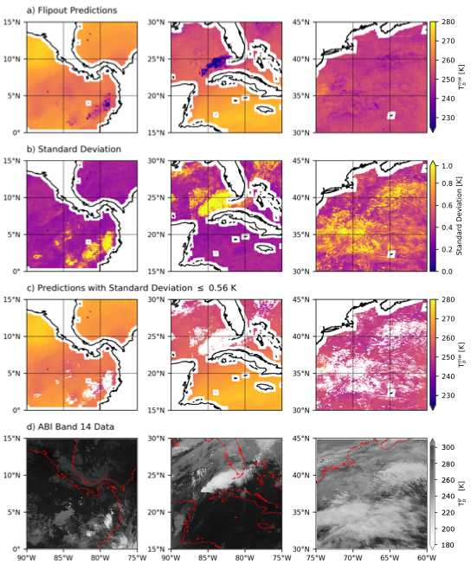

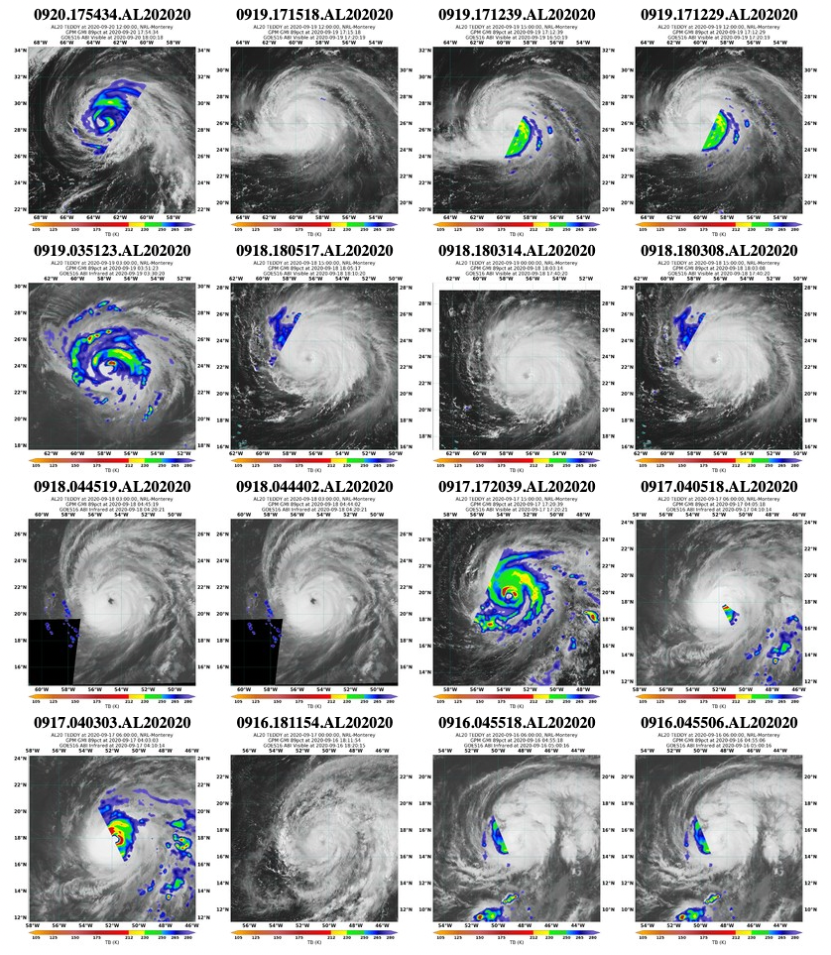
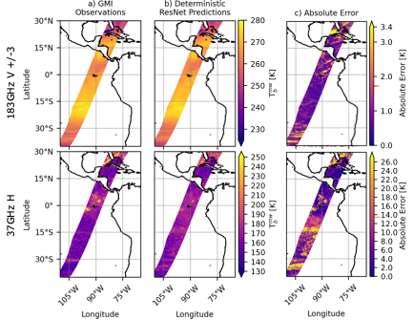
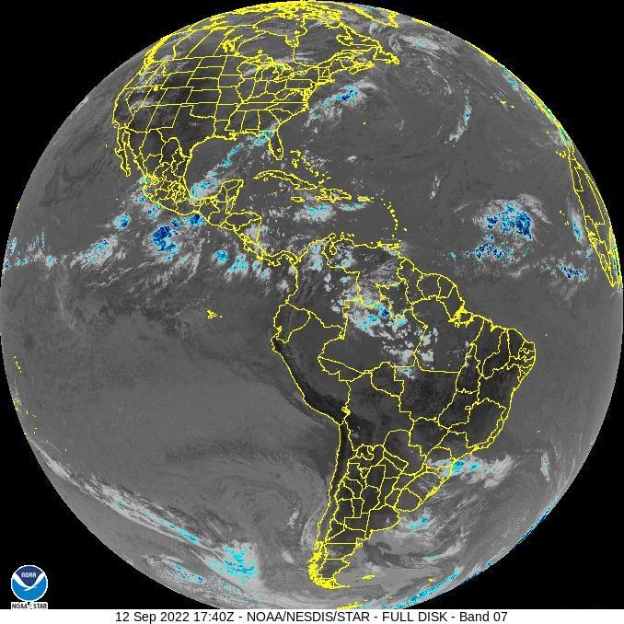
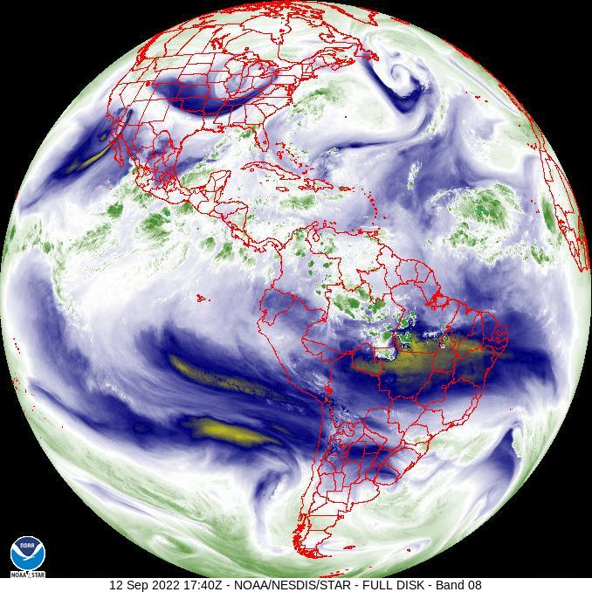
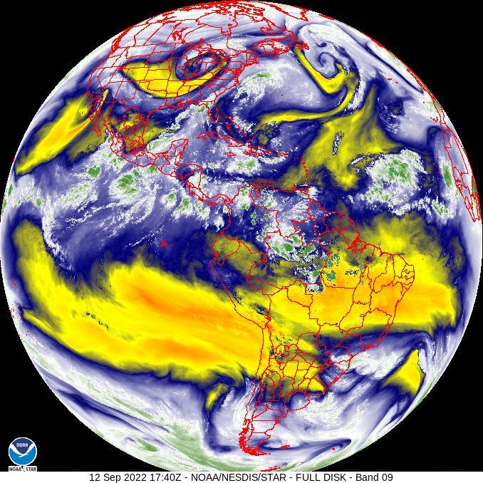
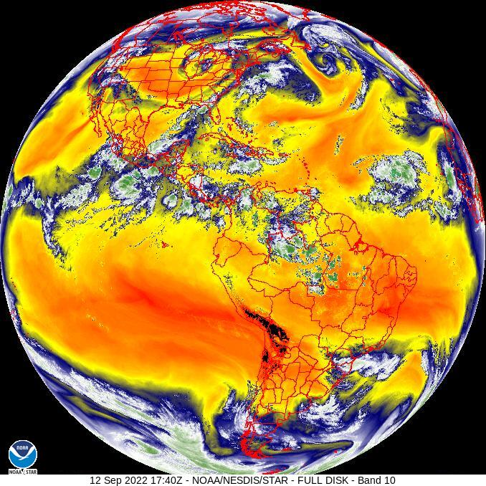
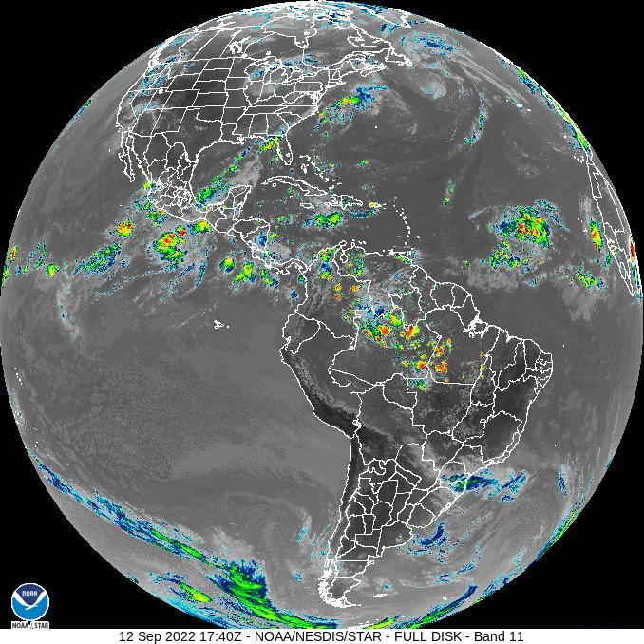
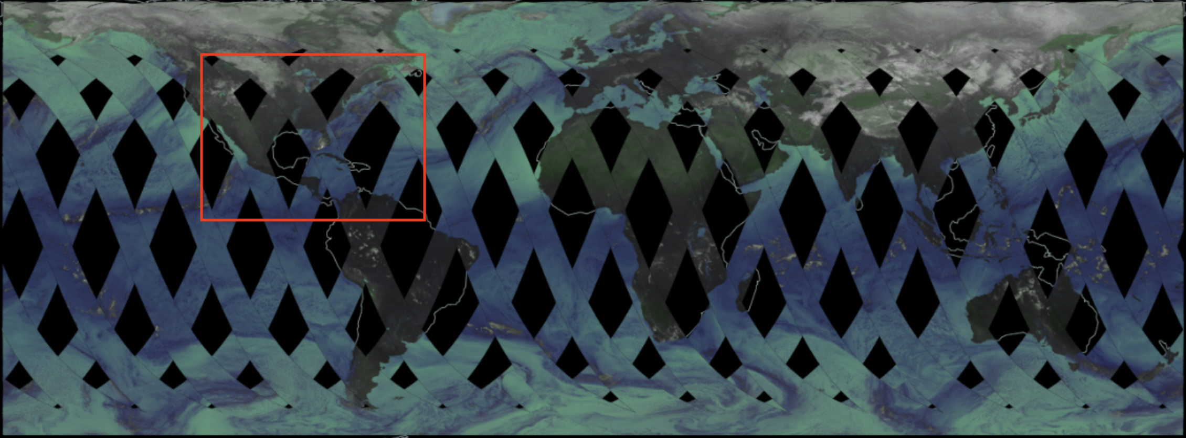
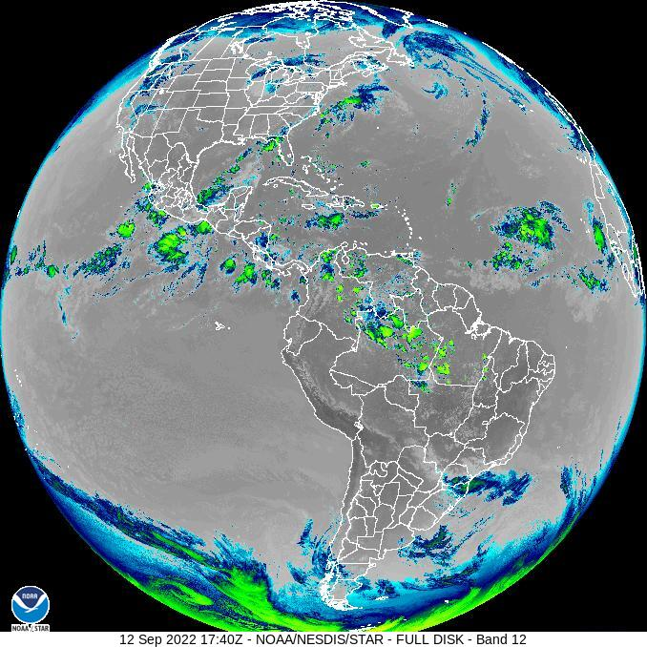
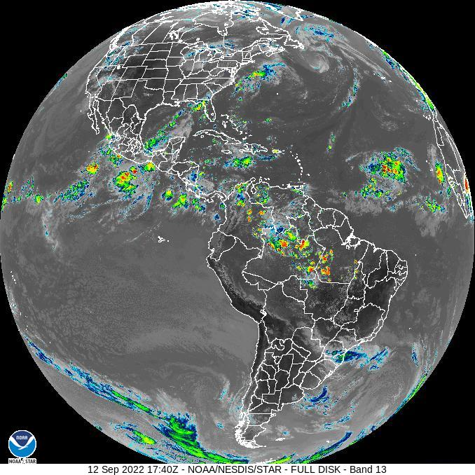
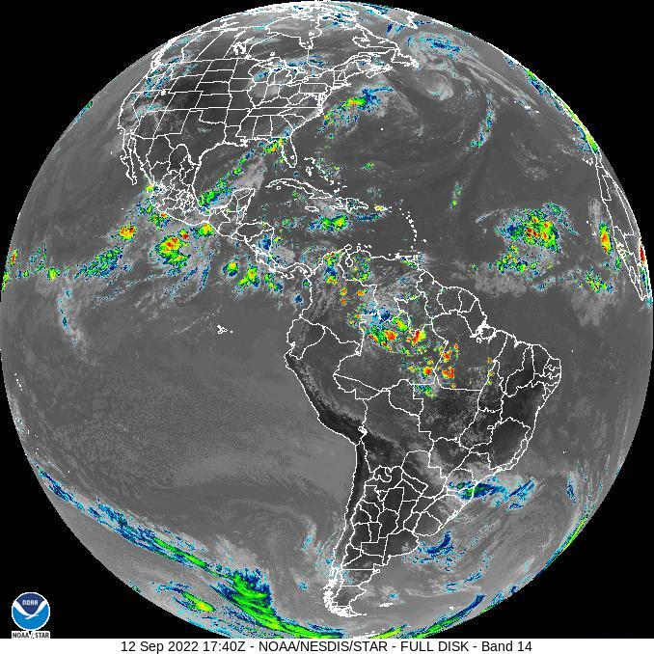
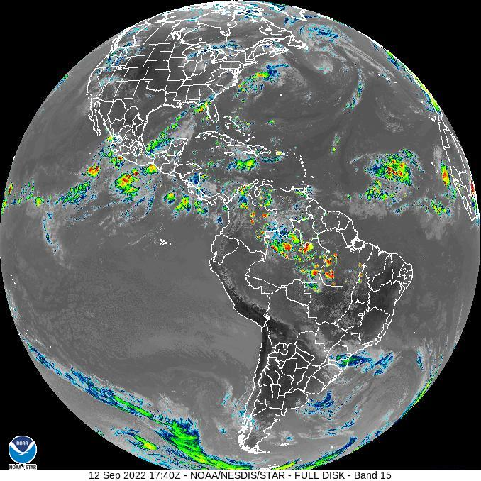
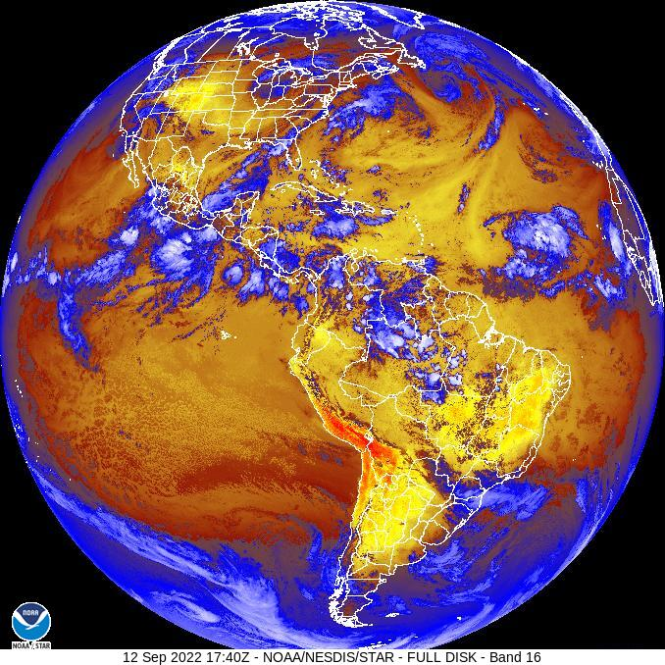




Towards Trusting Synthetic Microwave Retrievals: Introducing Uncertainty Quantification in a New Bayesian Convolutional Neural Network Architecture
Pedro Ortiz¹, Eleanor G. Casas^{1*}, Marko Orescanin¹, Scott W. Powell¹, Veljko Petkovic²
¹Naval Postgraduate School, ²University of Maryland *contact: eleanor.casas@nps.edu
Office of Naval Research grant N0001421WX00575 and
National Oceanic and Atmospheric Administration grant NA19NES4320002
(Cooperative Institute for Satellite Earth System Studies - CISESS) at the University of Maryland
MOTIVATION
RESULTS
Impact & ONGOING WORK
Pro: Satellite microwave brightness temperatures (TBs) provide highly useful information for a broad range of applications, including data assimilation, precipitation estimates, and tropical cyclone intensity assessments.
Con: They have large spatial and temporal gaps due to their low-Earth orbits, and they are relatively lower resolution than geostationary visible and infrared data.
b
Why does uncertainty calibration matter?
If ML models are well-calibrated, then we can use predicted uncertainty as a proxy for absolute error
Users can also specify thresholds of acceptable uncertainty as quality-control constraints for downstream applications
Uncertainty can also be used to assess predictability of different microphysical regimes for a given set of input features
Ex: data assimilation, real-time viewing, precipitation retrievals, etc.
Ex: 89 GHz TBs are useful for seeing tropical cyclone convective organization, but swaths rarely cover enough area to be useful (e.g. Hurricane Teddy (2020))
Fig. 1: Bayesian 183±3 GHz (V) predictions on 01 Feb 2020 using 1 month of training data
Fig. 2: Deterministic 183±3 GHz (V) predictions compared to 37 GHz (H) predictions with same training data
Clear-sky TBs have higher skill than cloudy/precipitating TBs
Higher frequency GMI channels associated with high atmospheric opacity and high sensitivity to water vapor (e.g. 183 GHz) have higher skill and less predicted uncertainty than others
Vertically-polarized channels tend to have higher skill than horizontally-polarized
Results indicate that there are minimal differences in skill between deterministic and all 3 Bayesian model architectures
Fig. 5: Application of uncertainty decomposition from sample mesoscale sectors in Fig. 1. Predictions in row (c) show only the top 80% most certain predictions.
https://worldview.earthdata.nasa.gov
https://www.nrlmry.navy.mil/TC.html
The results up to this point are currently undergoing peer review!
Uncertainty Calibration of Synthetic Microwave Brightness Temperatures from Bayesian Deep Learning Ortiz, P., E.G. Casas, M. Orescanin, S. Powell, and V. Petkovic
Research Goal & Questions
Goal: We would like to use Bayesian convolutional neural networks to ”fill in the gaps” by predicting microwave TBs from geostationary infrared data.
But there are multiple ways to make a Bayesian model, and how do we know whether it’s a “good” model or not? How can we trust model predictions?
We would like to answer the following questions:
Can we predict microwave TBs from infrared data?
Which Bayesian convolutional architecture is best suited for this task?
Is predicted uncertainty suitable for establishing trust in predictions?
How can predicted uncertainty tell us whether the model has enough training data?
Ongoing work-in-progress
Uncertainty can be decomposed into aleatoric and epistemic components
Aleatoric = irreducible uncertainty for the same input features
Epistemic = reducible uncertainty for the same input features
Knowledge of uncertainty decomposition allows for (1) curating smaller training datasets that contain only high-value information, and (2) knowing when you have enough training data
We are in the process of developing active learning models that train on data with high epistemic uncertainty
Preliminary results indicate that we have not yet reached the highest possible skill in 89 GHz (H) TBs for Hurricane Teddy (2020)
183±3 V
183±7 V
18.7 V
166 H
37 V
10.6 V
166 V
10.6 H
89 V
23 V
37 H
18.7 H
89 H
METHODS
Fig. 6: Latest Bayesian model results showing example predictions of Hurricane Teddy (2020) on 19 Sep 2020 using 6 months of IR training data and a modified architecture that allows for aleatoric and epistemic uncertainty decomposition. Future work will involve curating an optimal training dataset and exploring the utility of visible ABI bands.
Fig. 3: Bayesian Flipout model results of each GMI channel for 3 random days in Jan., Feb., and May.
(a) Features
Data | GOES-16 ABI Bands 7-16 (Near IR and IR) TBs
Spatial Resolution | 1 km² at Nadir
Temporal Resolution | Full Disk picture every 10-15 min
(b) Labels
Data | GMI TBs for each channel
Spatial Resolution | Channels range from 32 km² to 624 km² at Nadir
Temporal Resolution | Swath passes Equator every 45 min on avg.
Relationships between Predicted Uncertainty and Error
▲ GMI channels associated with higher average predicted uncertainty also tend to have higher average error
▼ “Calibration” = Monotonically increasing relationship between Percent of Predictions Retained vs Mean Absolute Error | We find that the Flipout configuration is the most robustly well-calibrated Bayesian model architecture for this regression task
conclusions
Can we predict microwave TBs from infrared data?
Yes, but some channels have higher skill than others for physical reasons. We find that skill differences between model architectures are minimal.
Which Bayesian convolutional architecture is best suited for this task?
We find that the Flipout configuration has the most robust calibration across GMI frequencies and is therefore the best suited for this task.
Is predicted uncertainty suitable for establishing trust in predictions?
Yes, as long as uncertainty is “calibrated” with error.
How can predicted uncertainty tell us whether the model has enough training data?
Predicted uncertainty can be decomposed into aleatoric and epistemic components, and near-zero epistemic uncertainty indicates that the model has enough training data.
https://www.star.nesdis.noaa.gov/GOES/fulldisk.php?sat=G17
https://worldview.earthdata.nasa.gov
(c) Scientific Objectives and Methods
Use Bayesian Deep Learning to create a synthetic product of microwave data and variances with the spatial and temporal resolution of IR data
Collocate matching IR patches and microwave pixels and create uniform distributions of GMI TB labels for balanced training data
Output both Microwave TBs and variance at IR resolutions for each GMI channel
Train deterministic CNNs and 3 types of Bayesian models (Flipout, Monte Carlo Dropout, and Reparameterization) with the ELBO loss function
(Ongoing) Decompose resulting variance into epistemic and aleatoric components
✓ Flipout
✓ MC Dropout
Reparam.
✓ Flipout
✓ MC Dropout
✓ Reparam.
✓ Flipout
✓ MC Dropout
Reparam.
✓ Flipout
MC Dropout
Reparam.
Fig. 4: Comparison of calibrations between predicted uncertainty vs absolute error for Bayesian Flipout, Monte Carlo Dropout, and Reparameterization architectures

